Slide 1

Shipping & Logistics Solution
[Jupiter Business Manager]
Satyanath Bhat
Jupiter Business Systems FZC
© 2006, All Rights Reserved.

Slide 2
Agenda
NVOCC Liner and Liner Agency Solution
Container Trading Solution

Slide 3

Exploring NVOCC Liner Module
[Jupiter Business Manager]

Slide 4
NVOCC Liner Module
Solution Overview
Multi Geography
External Agent Vs. Group Company
Integrated Financials
Get your agents online
Strong inventory control
Agent to Agent communication automated
Workflow automation with the agent

Slide 5
NVOCC Liner Module
NVOCC Organization
Liner Service Location (mapped to UN location)
Multiple Agent per location
External Agent Vs. Group Company
Group Level consolidation
Configurable Agent Contracts
Agent to Agent communication automated

Slide 6


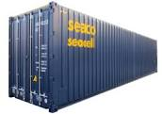


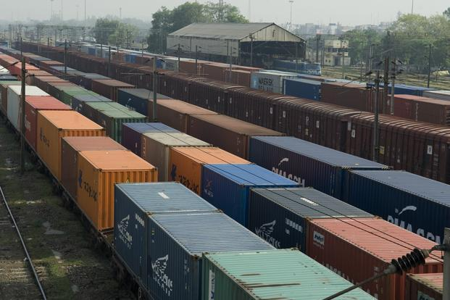
NVOCC Liner Module
Cost of Operations
System Features Following Tariff Profile
  THC Cost by terminal operator
  THC Recovery by Location/Port
  Local agent recovery tariff (DO/BLF)
  Detention tariff
  Storage tariff by Depot/Terminal
Agent contracts with commission configurations
Slot Charges
Lease Costs (part of the contract)
TERMINAL OPERATOR
DEPOT/REPAIRS
CONTAINER LEASE
SLOT OPERATOR
RAIL/ICD
TRANSPORTER
Note: These tariff profiles are effectively used for pricing, invoicing, purchase invoice processing and reporting.

Slide 7
NVOCC Liner Module
Pricing Control
Standard Card Rate
Rate Request for Special Rate
Rate Calculator for pricing approval (round trip costing)
Detention Free days extension requests & approval
Connect Rates to Manifest

Slide 8
NVOCC Liner Module
Global Container Tracking
Configurable Movements
Agents to update the movements
Update by Excel/EDI
Leased or Purchase Containers
Alerts on delinquent containers
Detention, storage, lease costs calculations
Integration with Financials

Slide 9
NVOCC Liner Module
Documentation & Manifest
Line Publishes Sailing Schedule
Agent can do booking
Issues BOL
Finalize Manifest (as per the TDR)

Slide 10
NVOCC Liner Module
Core Financials
Manifest Database
Voyage Register
Auto Calculation of Agent Invoice
Accrual based accounting
P&L is booked with sailing
Auto reconciliation and disbursements
Slot Cost Provision
Price control

Slide 11
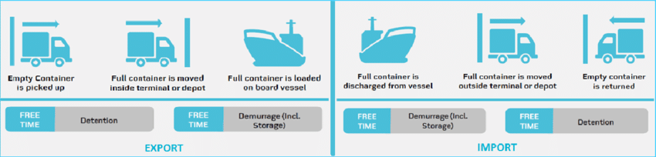
NVOCC Liner Module
Detention Invoicing
Detention tariff profile
Auto calculation for Detention invoice based on container movement
Free days approval from rate request process
Fortnightly invoice to agent
Direct P&L booking

Slide 12

NVOCC Liner Module
Maintenance & Repairs
Repair Request
Approval
History of Repairs
Tracking of damage and repair by IICL codes
Prevent repetitive repairs and control cost

Slide 13
NVOCC Liner Module
MIS Reports
Volume Performance
Revenue Performance
Sector Analysis
Equipment Type wise Analysis
Agent Analysis
Cost Element Analysis
Dashboards with Graphical & Pivot Driven

Slide 14
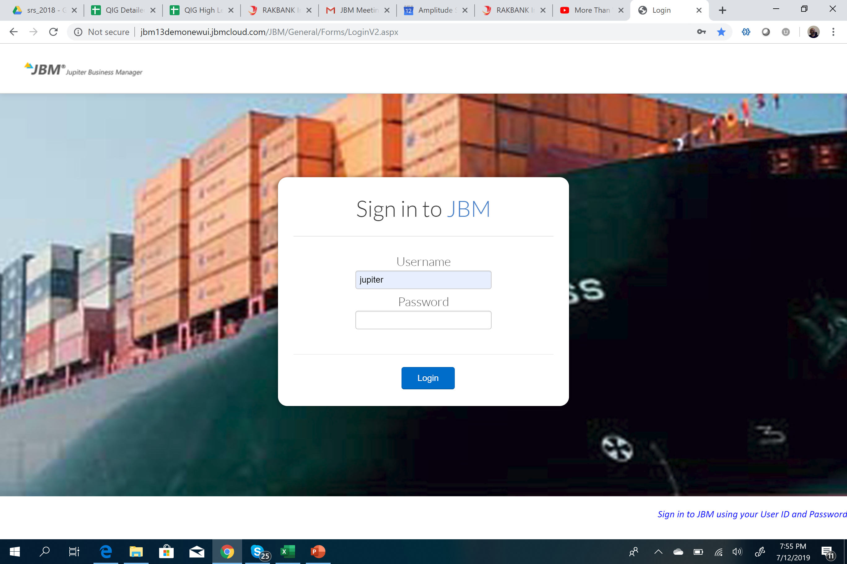
NVOCC Liner Module - Screenshots
Login page

Slide 15
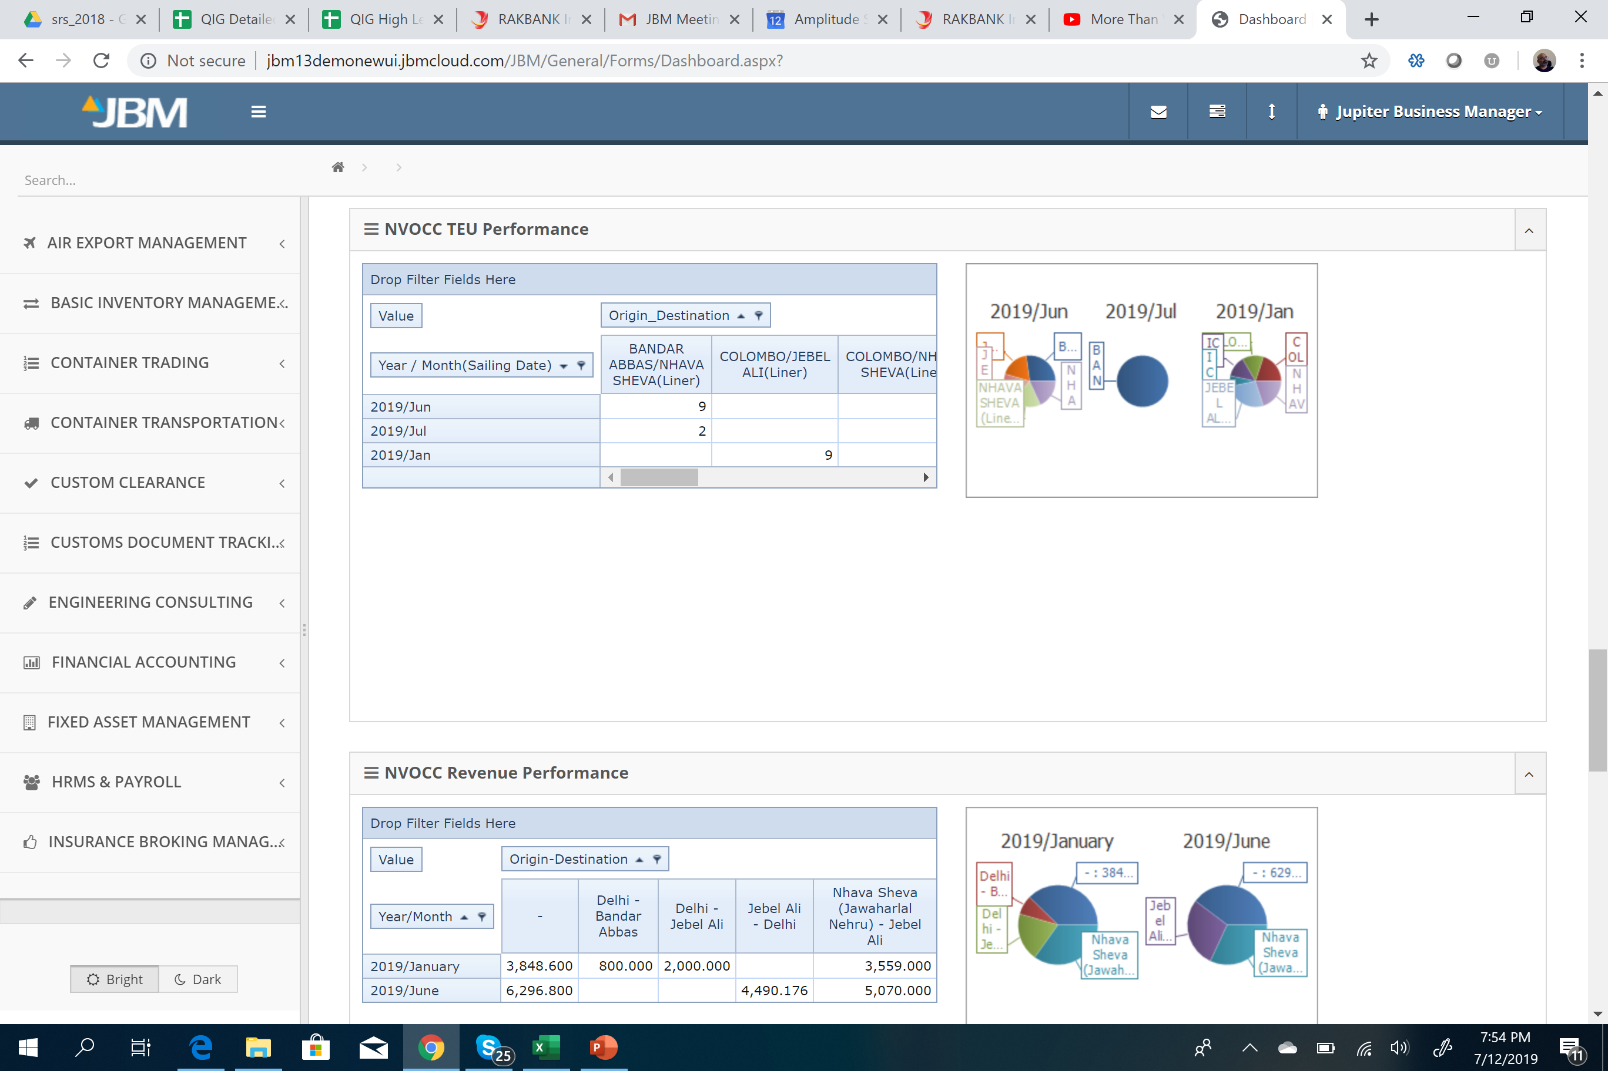
NVOCC Liner Module - Screenshots
Home Page
Multi modules for different verticals
Home page widgets
Access control
Work-flow dashboards
Alerts
Dashboards with Graphical & Pivot Driven

Slide 16
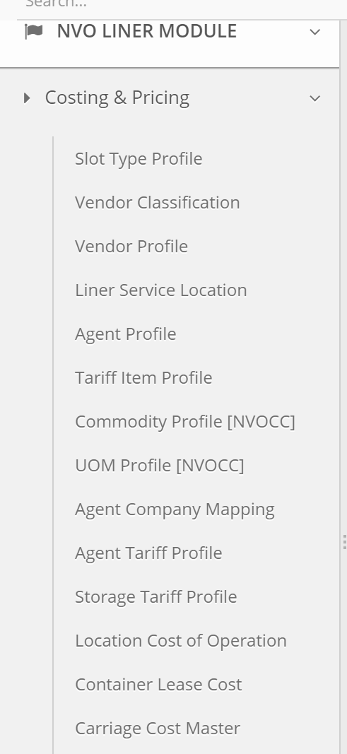
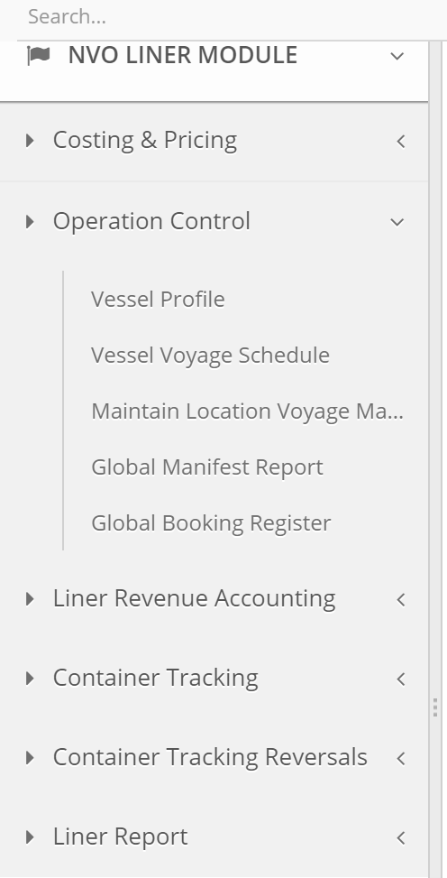
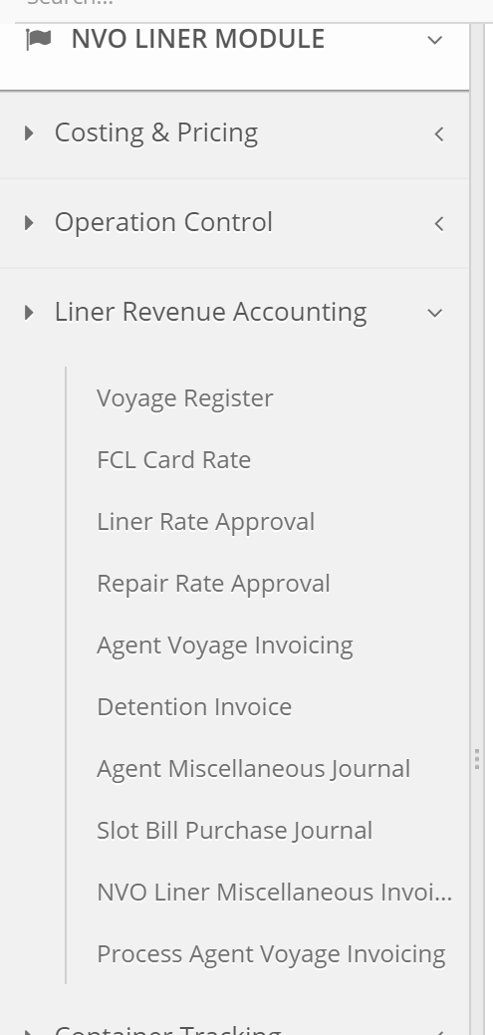
NVOCC Liner Module - Screenshots
NVO Liner Menu Overview

Slide 17
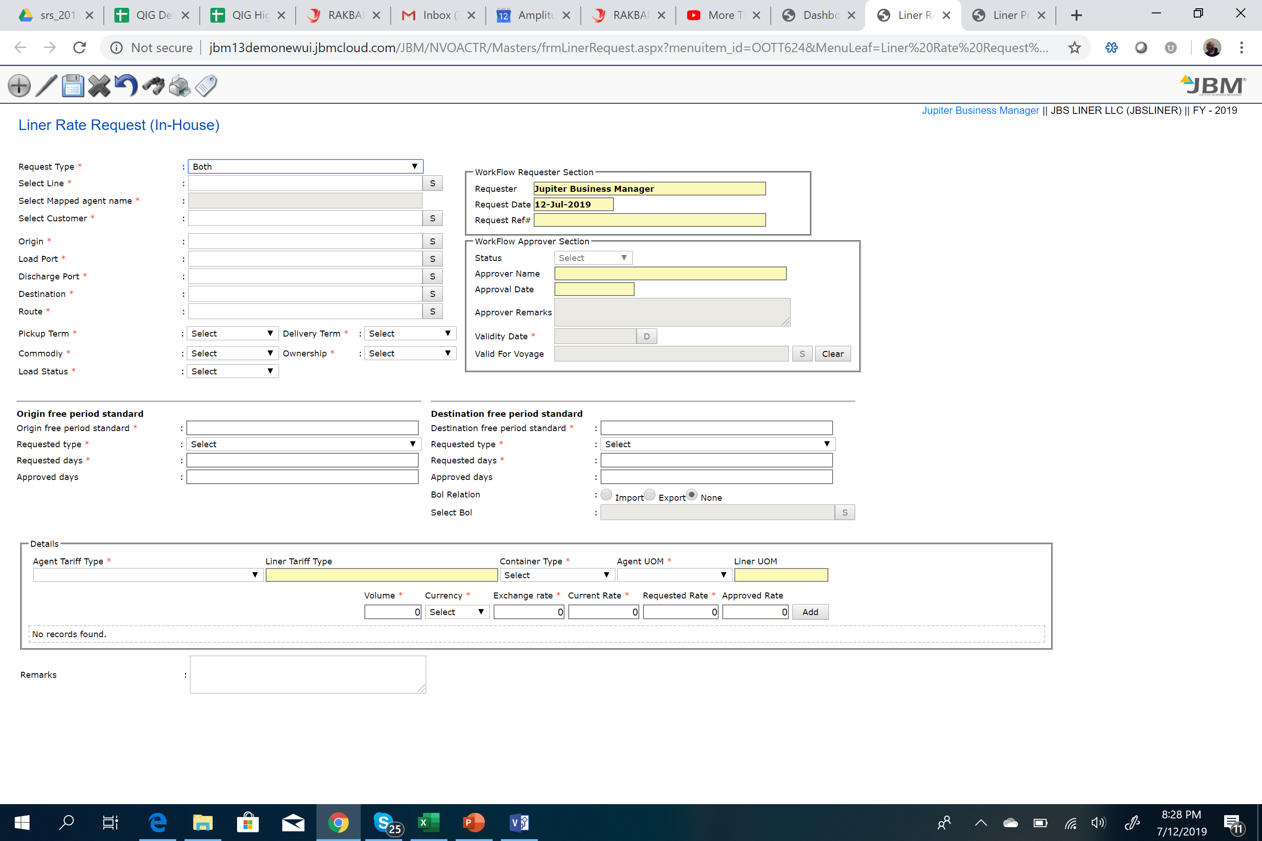
NVOCC Liner Module - Screenshots
Rate Request
Pricing control
Combined rate approval with free period
Integrated work-sheet
Manifest linked to rates
Agent request/line approval

Slide 18
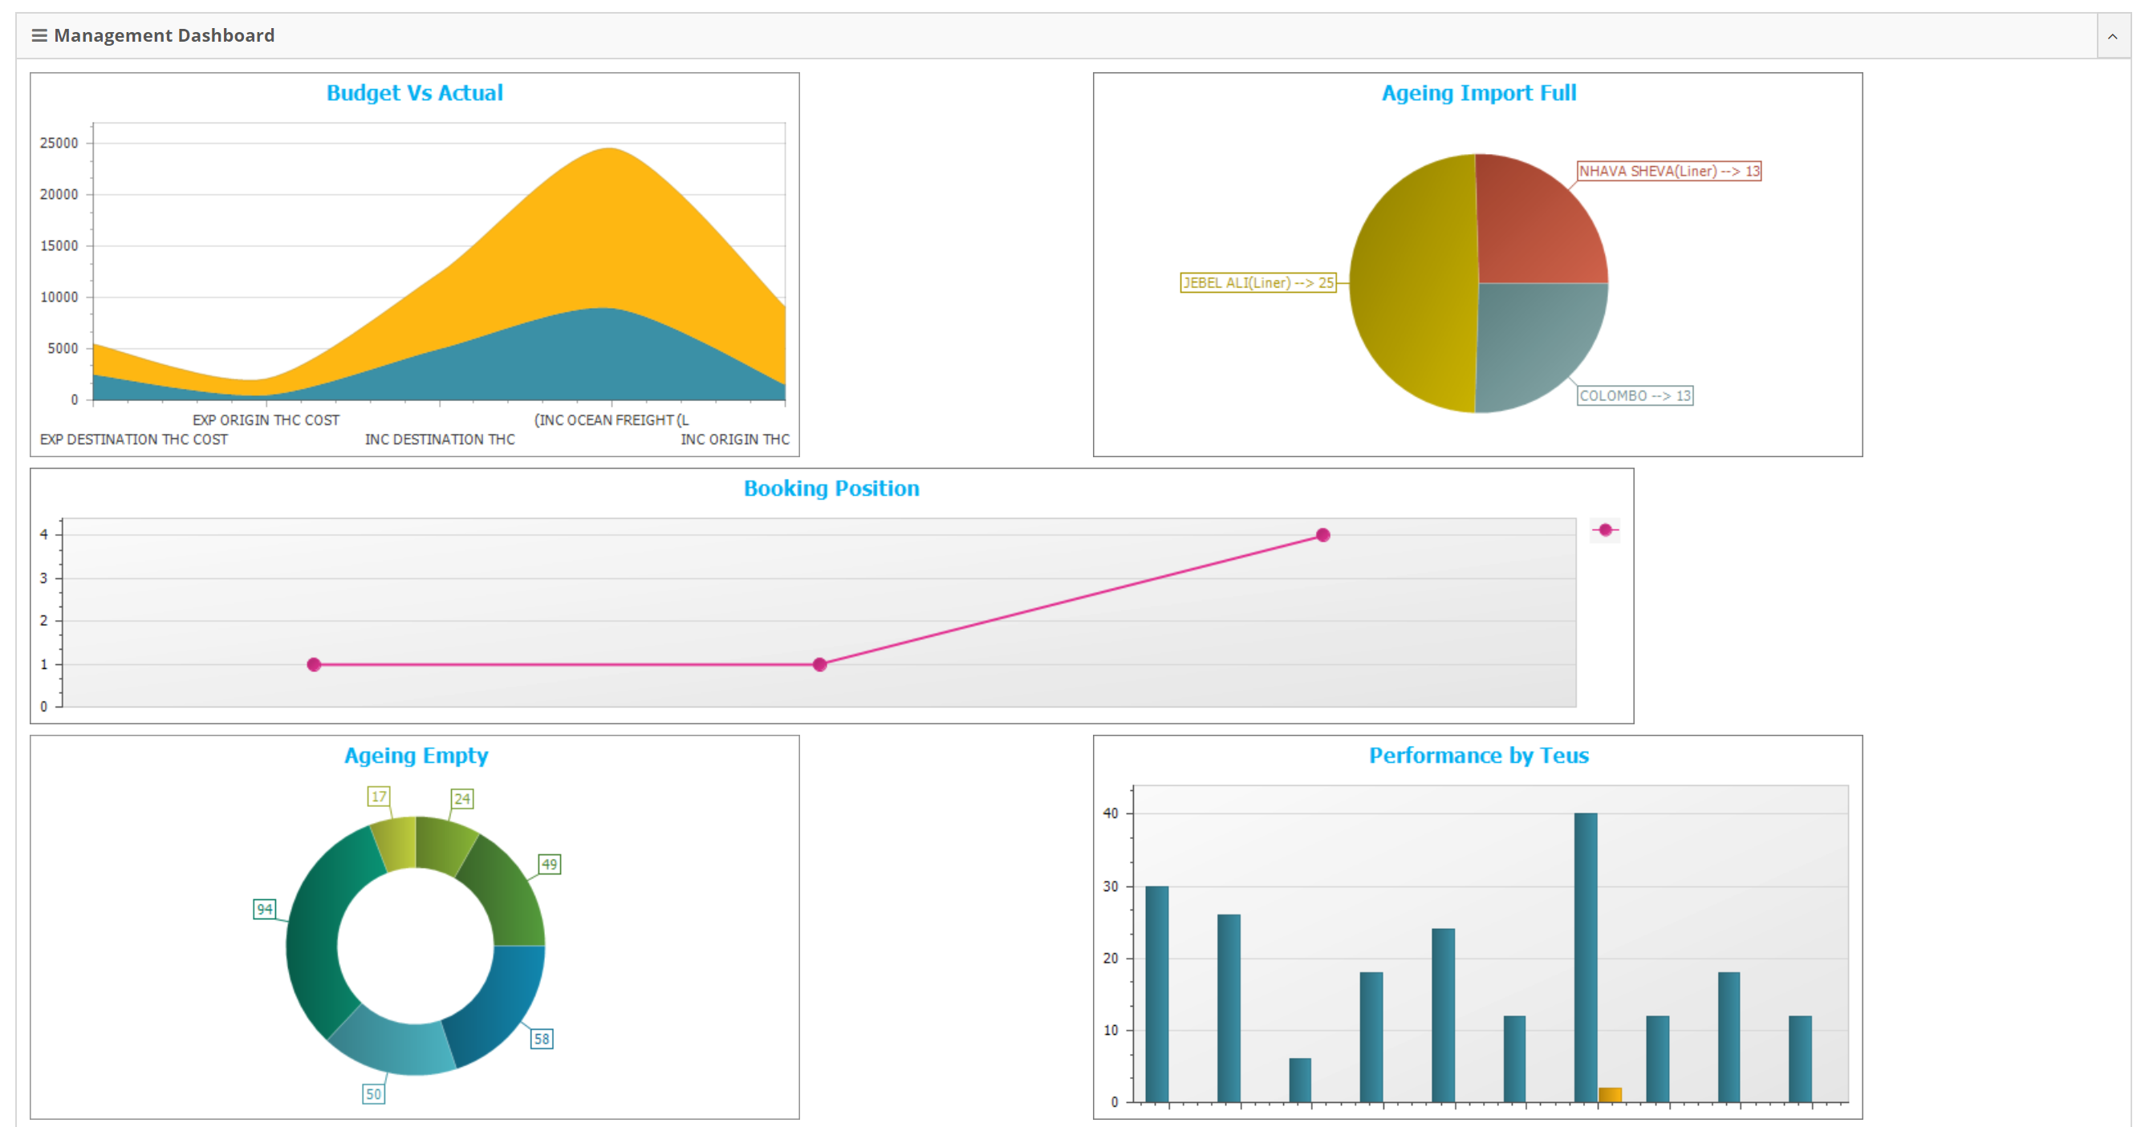
NVOCC Liner Module - Screenshots
Management Dashboard

Slide 19
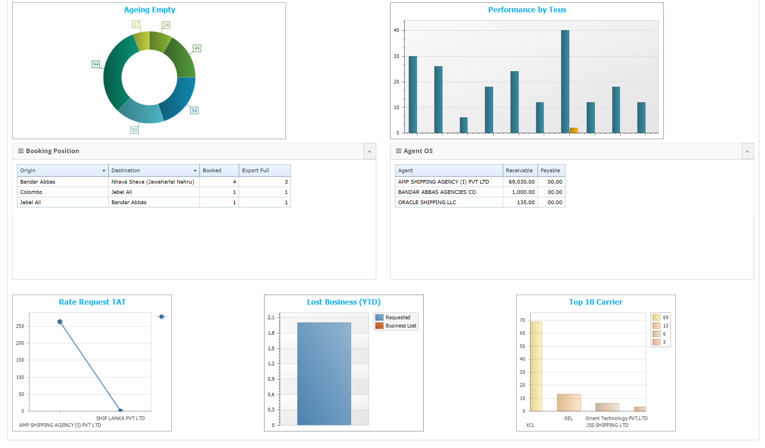
NVOCC Liner Module - Screenshots
Management Dashboard

Slide 20
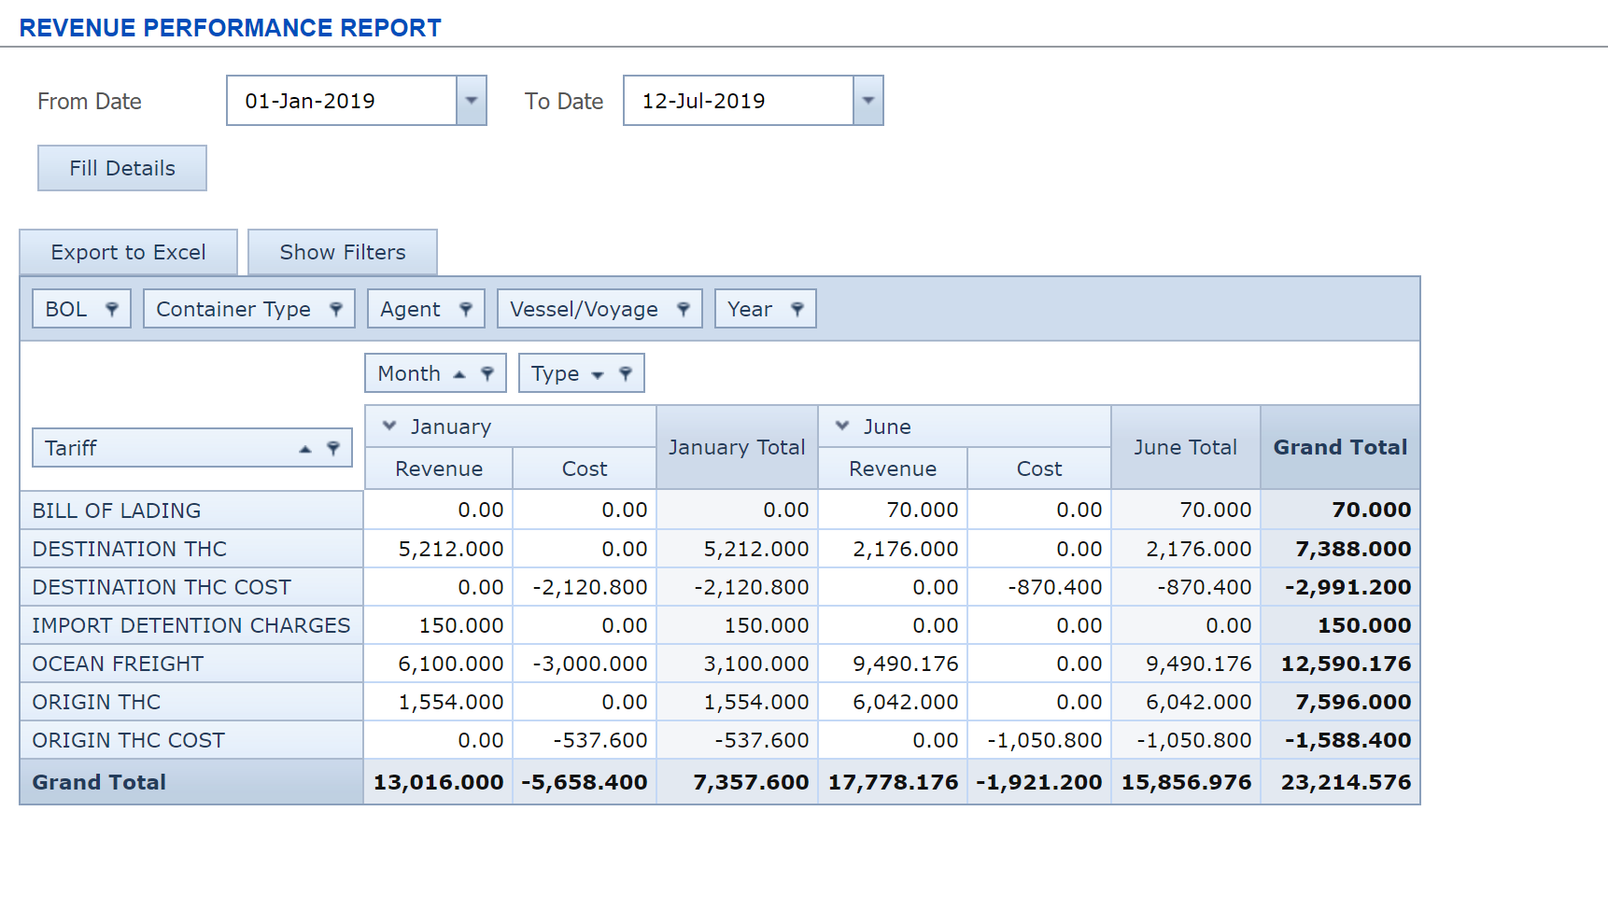
NVOCC Liner Module - Screenshots
Revenue Performance
Onscreen Pivot
Drilldown on each fields to container level
Generate for any period
Total P&L reconciliation
Revenue recognition with every sailing

Slide 21
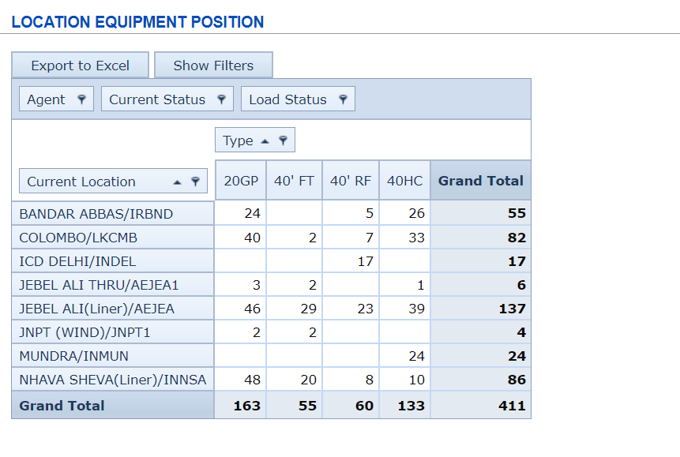
NVOCC Liner Module - Screenshots
Location Equipment Stock
Onscreen Pivot
Drilldown on each fields to container level
Generate for any period

Slide 22
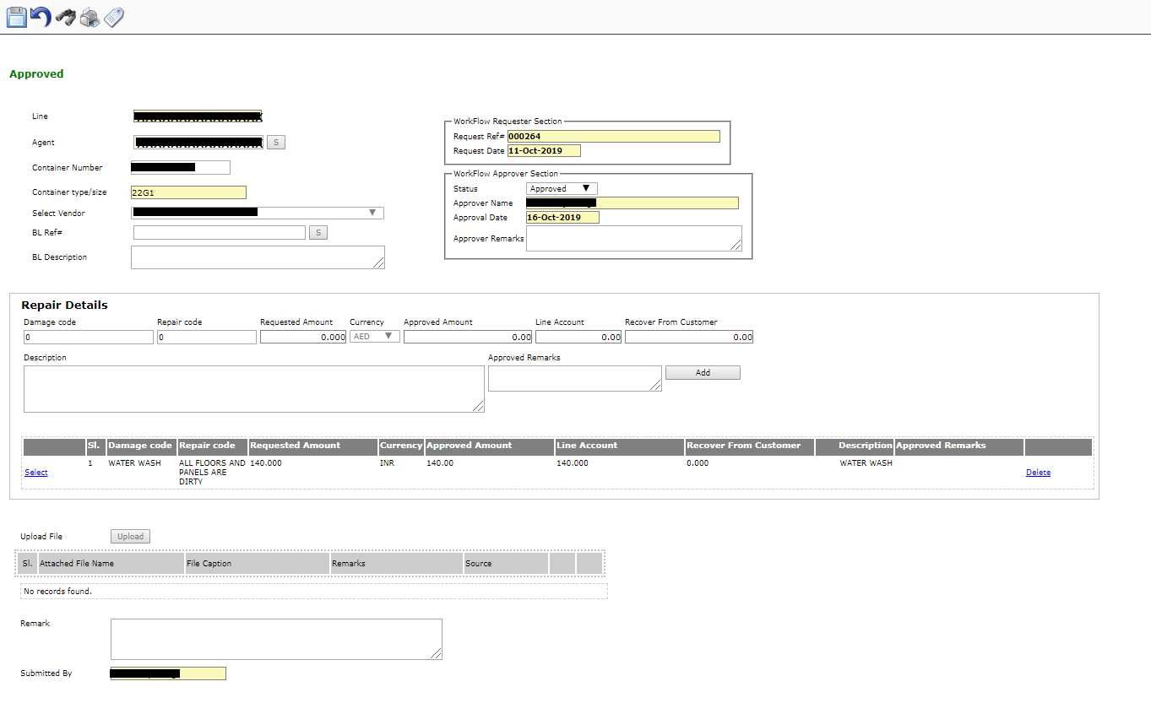
NVOCC Liner Module - Screenshots
Container Repair Request
Agent Request
Principal Approval
Masters for Damage code and Repair Codes
History of repairs carried out
Attachments for estimates and images
Purchase Invoice against the approved ref#

Slide 23
Exploring Liner Agency Module
[Jupiter Business Manager]

Slide 24
Liner Agency Module
Solution Overview
Multi Geography
Multi Principal
Inhouse & External Principal
Compliant with ports/customs across the region
System Alerts
Configurable System
Integrated JBM Financials
Support Sea and Dry port operations
All standards and EDI data compatibility

Slide 25
Liner Agency Module
Agent Container Tracking
Configurable Movements by Principal
Integration with Inhouse Line’s NVO Module
Manual/Excel Updates
CODECO/COARRI integration with DPW
Customized reports for lines reporting
Alerts on delinquent containers
Detention, storage, lease costs calculations
Stock position by principals

Slide 26
Liner Agency Module
Export Operations
Booking Management
Release Management
Load Planning
Slot Management
Complete Documentation (BOL/MRN/MANIFESTS)
Invoicing and Credit Control
Tax compliance and statutory needs
Document Finalization and Liner reporting
Export Customs Documentations
Express Releases

Slide 27
Liner Agency Module
Import Operations
Discharge list till delivery
Import Manifest
EDI manifest submission across region (Ports/Customs)
Arrival Notice/Reminder(s) [Fax, Email, SMS]
Delivery Control
Auto calculation invoices (detention an storage charges)
Manage Discounts/Waivers
Credit Control
Multiple Invoices/Cash Collection Management
Liner Reporting
Delinquent container tracking
Accrued Detention Reporting

Slide 28
Liner Agency Module
LA Financials
Integrated with JBM Financials
Accrual Based accounting
Clearing Accounts for al Liner Collections
Liner SOA with automated commission calculations
Vendor bill processing
Liner Reporting

Slide 29
Liner Agency Module
Agent MIS
Volume and Revenue Performance
Analysis by sales person
Analysis by Customer
Analysis Principal
Commodity Analysis
Sector Analysis
Container Inventory Control

Slide 30
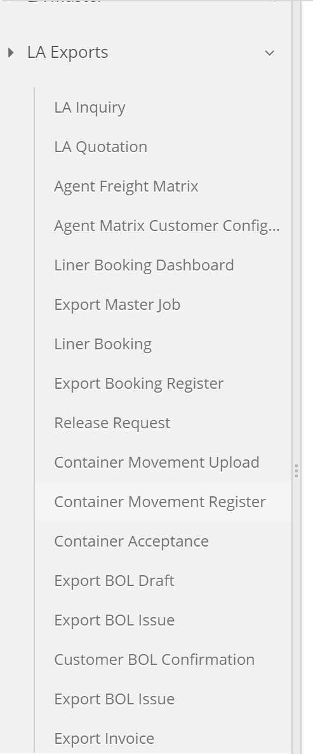
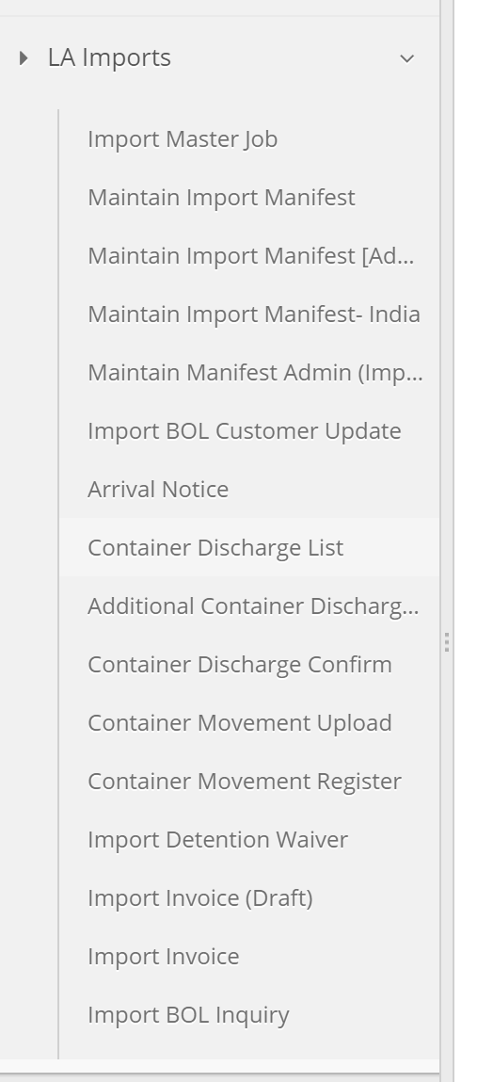
Liner Agency - Screenshots
Menu

Slide 31
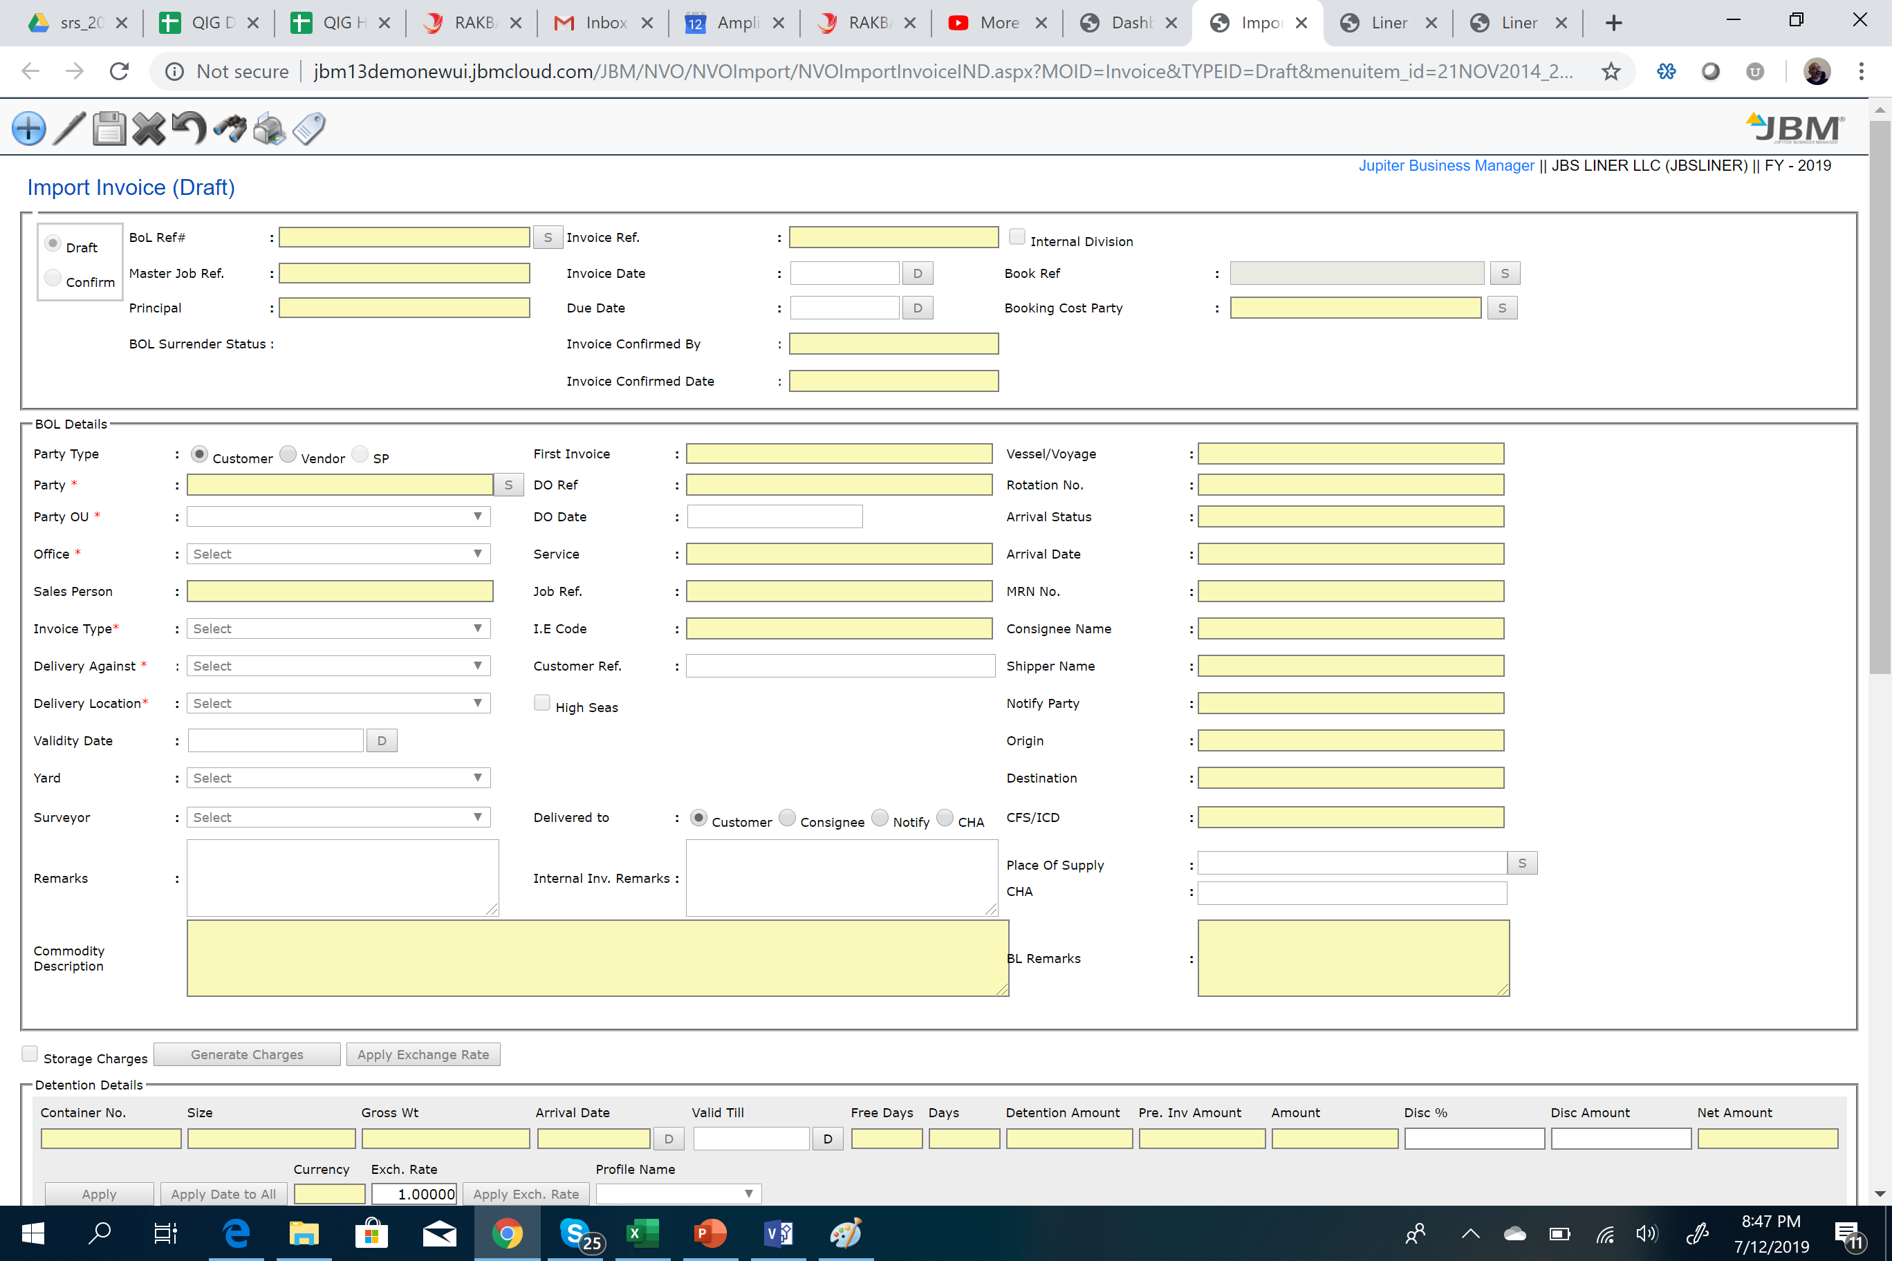
Liner Agency - Screenshots
Import Invoice
Auto calculation of detention, storage
Complete control on revenue recognition
VAT/GST compliance with FA integration

Slide 32

Thank you.
Q & A

